Slide 1
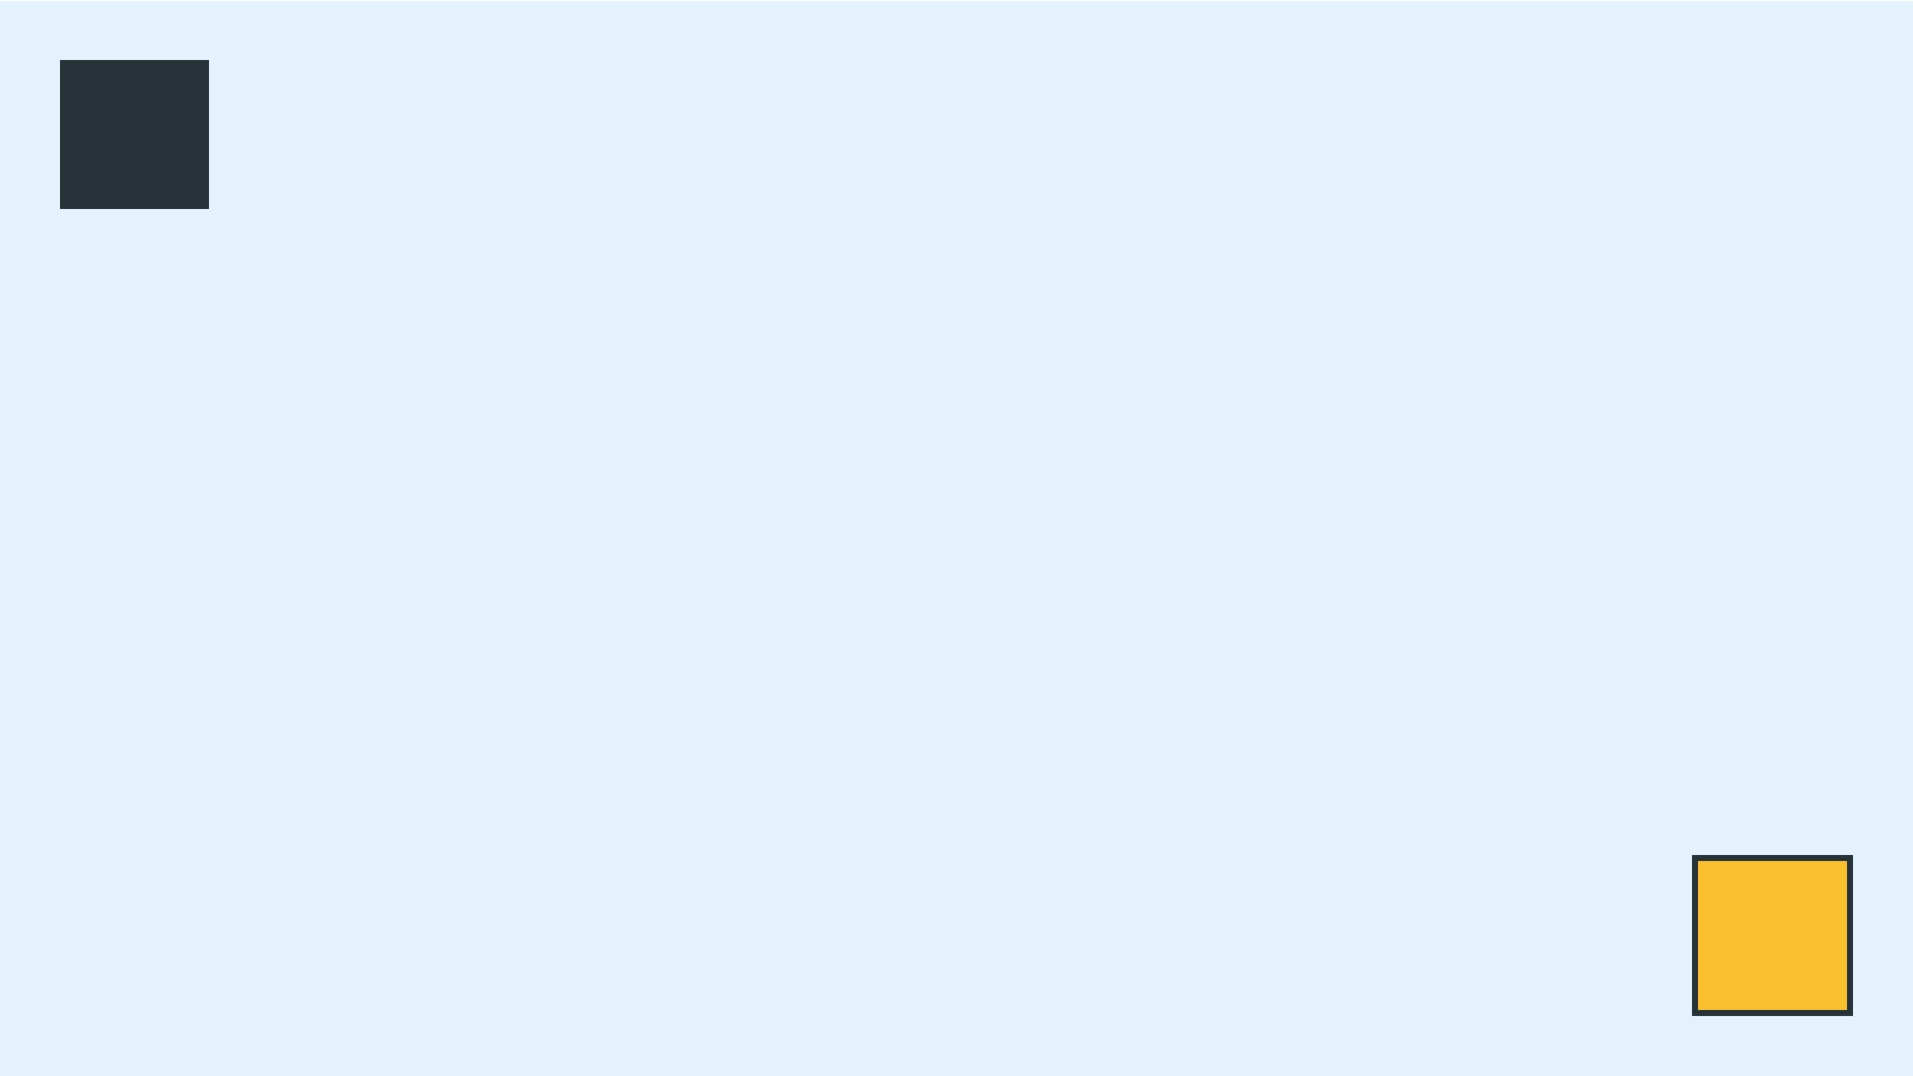
ARCHITECTURAL STRIKE TEAMS: RESPONSIBILITY-DRIVEN DESIGN & SYSTEMS CONTROL
SWE30003 - Week 6 Case Study Presentations
Notes:
Welcome, everyone. We're diving deep into architectural strategies for software design today. Our focus is Responsibility-Driven Design and its application in automated systems control. This presentation explores how robust architectural principles solve complex development challenges. We'll use two case studies: an Automated Attendance System and the Towers of Hanoi Project. These examples will illustrate key concepts in action.

Slide 2

THE SCENARIO - SYSTEM BACKGROUND
Automated Attendance System
Towers of Hanoi Simulation
Transition: From manual paper-based logs to rapid card-swiping.
Background: Ancient puzzle of moving 64 rings across 3 poles.
OOD Rule 1: Only one ring can be moved at a time.
Primary Goal: Eliminate proxy cheating and improve data accuracy.
OOD Rule 2: A larger ring cannot sit on a smaller ring.
Foundational: Laying the groundwork for future modular door-locking and facility management.
Constraint: Objects must encapsulate their own state and validation logic.
Notes:
To set the stage, we're examining two distinct domain contexts. First, the Swinburne Automated Attendance System. It's modernizing from manual logs to a digital card-swipe system. This isn't just about attendance; it's about security and building a modular foundation for future access control. Second, we have the Towers of Hanoi simulation. While a classic puzzle, we treat it as a rigorous Object-Oriented Design exercise. The rules translate directly into software constraints: state management, encapsulation, and rule validation. These scenarios provide rich ground for architectural exploration.

Slide 3
OBJECT DISCOVERY - ANALYSIS & CANDIDATE CLASSES
Noun-Phrase Analysis: Identifying potential objects from the requirement specifications.
Student
Lecturer
ClassSession
StudentId
StaffId
SessionID
Name
Name
CourseCode
CardUID
Department
StartTime
EndTime
AttendanceRecord
AccessDevice
RecordID
DeviceID
Timestamp
Location
Status (Present/Late)
Status (Active/Offline)
Notes:
Following our scenario, Group 1's first task is Object Discovery using Noun-Phrase analysis. By scanning our system brief, we identify key entities that have both state and behavior. Student, Lecturer, ClassSession, AttendanceRecord, and AccessDevice emerge as our primary candidate classes. Each is defined by its structural attributes. For instance, a ClassSession is defined by its ID, course, and time boundaries. This step is crucial for establishing the initial domain model. But not every noun makes the cut.

Slide 4

THE OBJECT DISCOVERY DISCARD PILE
EXTERNAL ACTOR
IRRELEVANT CONCEPT
SIMPLE ATTRIBUTE
Swinburne University
Hallway / Congestion
CardUID / Timestamp
ARCHITECTURAL RATIONALE
ARCHITECTURAL RATIONALE
ARCHITECTURAL RATIONALE
Entities that interact with the system but
Nouns that don't contribute to functional
Nouns better represented as primitive
data types. These lack independent
are not *of* the system. It is the context,
requirements. While physical factors, they
behavior; they describe a Student or a
not a class we need to model internal
logic for.
don't hold state or behavior relevant to
Record.
attendance logic.
Notes:
Not every noun becomes a class, and we must be disciplined to avoid 'class bloat.' We discard External Actors like 'Swinburne' because we don't manage the university's internal state. We discard Irrelevant Concepts like 'Hallway' as they don't impact our business logic. Finally, we demote Simple Attributes like 'CardUID' or 'Timestamp' to properties of other classes. This ensures our class diagram remains focused on entities with meaningful responsibilities. Now, let's see what responsibilities these chosen classes hold.

Slide 5
CLASS ROLES & SYSTEM INTELLIGENCE
FOCUS: THE CLASSSESSION CLASS
PRIMARY ROLES
ENCAPSULATED INTELLIGENCE
Information Holder: Maintains the definitive list of expected students and session metadata.
Collection Management: Responsible for maintaining the set of AttendanceRecords for its specific instance.
Coordinator: Acts as the central hub for the attendance event lifecycle and synchronization.
Grace Period Logic: Determines if a swipe is "On-Time" or "Late" based on university policy.
Notes:
Let's look at ClassSession. In a Responsibility-Driven Design, we don't just see it as a data table. It is an Information Holder for the session's context and a Coordinator for the attendance process. Most importantly, it encapsulates intelligence. It manages its own collection of records and performs grace period calculations. By putting this logic here, we ensure that the 'knowledge' of what constitutes a valid attendance event stays within the object that owns the session data. This distribution of intelligence is key.

Slide 6
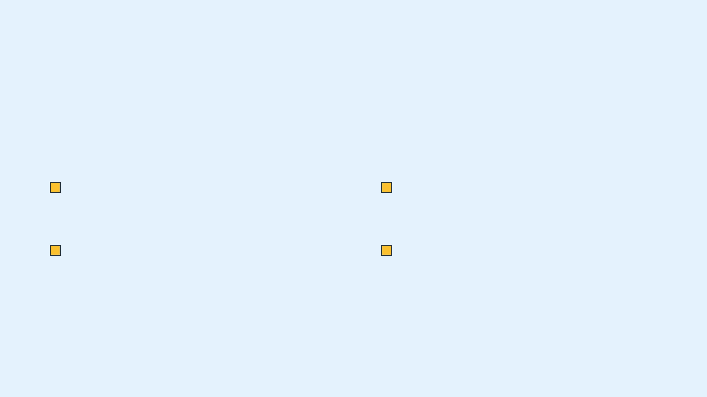
RESPONSIBILITY ARCHITECTURE - DOING VS. KNOWING
ARCHITECTURAL GOAL: PREVENT THE GOD CLASS (THE BLOB)
KNOWING RESPONSIBILITIES
DOING RESPONSIBILITIES
Student Card Mapping
Lifecycle Validation
Knowing which CardUID belongs to which StudentId.
Executing state transitions of an AttendanceRecord (e.g., Verified).
ClassSession State Tracking
Signal Broadcasting
Knowing if the session is active, expired, or in grace period.
Triggering physical hardware responses (lock-control) based on logic.
Notes:
Group 2 focuses on the "Knowing vs. Doing" distinction. To avoid a centralized God Class, we split responsibilities. Knowing is about state—like mapping cards to IDs or tracking session status. Doing is about action—validating a record's lifecycle or broadcasting signals to hardware. By separating these, we ensure that no single class becomes an all-knowing "Blob," making the system more modular and easier to test.

Slide 7

THE INFORMATION EXPERT PRINCIPLE
GRASP INFORMATION EXPERT
"Assign a responsibility to the class that has the information necessary to fulfill it."
Case Study: Hanoi Move Legality
Architectural Proof
The Rule: A larger ring cannot be placed on a smaller ring.
The Pole class maintains the stack of rings.
The Question: Who should validate if a move is legal?
The Pole knows the size of its current top ring.
Therefore, the Pole—not the Ring or Controller—must be the entity that validates move legality.
Notes:
Using the Hanoi project, we apply the Information Expert principle. When we ask, "Can I place this ring here?", who should answer? The Pole is the expert because it owns the stack and knows what's on top. If we put this logic in the GameController, we'd be forcing the controller to "ask" the pole for its data, breaking encapsulation. By making the Pole responsible, we keep the logic where the data lives. This leads us to consider another common architectural pitfall.

Slide 8

THE SETUP PROBLEM & OOD CREEP
Critique: Forcing Ring or Pole to handle game initialization is a fundamental design flaw.
1. SRP BREACH
2. HIGH COUPLING
3. COHESION BREAKDOWN
A Pole should manage its stack, not know
Domain objects become dependent on
The class becomes a fragmented mix of
how to "create" a game world. Mixing logic
specific setup configurations, making them
"being a domain entity" and "being a game
leads to multiple reasons for change.
less reusable and harder to test in isolation.
launcher," diluting its core purpose.
ARCHITECTURAL SOLUTION
Implement a Creational Pattern (Factory) or a dedicated Coordinator class to handle orchestration.
Notes:
A common mistake is "OOD Creep," where we force domain objects like Ring or Pole to handle their own setup. This is a clear SRP breach. A Pole should be an expert on its stack, not an expert on how to initialize a 64-ring game. This creates unnecessary coupling. The architectural fix is to use a Creational Pattern or a dedicated Coordinator to set up the world, leaving our domain objects clean and focused on their core logic. This separation of concerns extends to how objects communicate.

Slide 9

MESSAGE-PASSING CONTRACTS - CLIENTS & SERVERS
ALAN KAY’S VISION: OBJECTS AS BIOLOGICAL CELLS
CLIENT: GAMECONTROLLER
SERVER: POLE CLASS
Responsibility: Orchestrates the high-level sequence of the game.
Responsibility: Executes internal logic and maintains stack integrity.
Interaction: Does not "move" rings; it sends requests to the Poles.
Interaction:
Receives messages like
accept(Ring)
.
Knowledge: Expert on its own ring stack and validation rules.
Knowledge: Knows the game state but not the internal structure of the Poles.
THE CONTRACT: Interaction through interfaces, preserving encapsulation and hiding internal complexity.
Notes:
Group 3 explores Alan Kay's vision of Message-Passing. We view our objects as a network of Clients and Servers. When moving a ring, the GameController (Client) sends a message to the Pole (Server). The controller doesn't need to know how the pole stores rings—it just trusts the contract. This "Contractual Interaction" is the heart of true OOD, ensuring that objects interact through interfaces, not by poking at each other's guts. Let's see this in action with a walkthrough.

Slide 10
THE OBJECT COLLABORATION WALKTHROUGH
01
REQUEST
GameController sends canAccept(Ring) to Pole 3.
02
VALIDATION
Pole 3 checks its top ring and returns True.
03
EXTRACTION
GameController sends releaseTop() to Pole 1.
04
TRANSFER
GameController sends receive(Ring) to Pole 3.
05
CONFIRMATION
Pole 3 updates its internal stack and confirms success.
RESULT: ENCAPSULATION BOUNDARIES PRESERVED; NO DIRECT COLLECTION ACCESS.
Notes:
Let's walk through the collaboration. It's a 5-step dance. The controller first asks the destination if it can accept the ring. Only after validation does it ask the source to release the ring and then tells the destination to receive it. Notice that at no point does the GameController touch an array or a list. It passes messages, preserving the encapsulation of both poles. This perfectly illustrates the "Tell, Don't Ask" principle.

Slide 11

THE "TELL, DON'T ASK" PRINCIPLE
PROCEDURAL (BAD)
CLEAN OOD (GOOD)
// Asking for data var stack = pole.getStack(); if (ring.size < stack.top().size) { stack.push(ring); }
// Telling the object to act pole.add(ring); // Internal logic is hidden
ARCHITECTURAL BENEFITS
Hides Data Structures
Reduced Temporal Coupling
The Pole could use a List, Stack, or Array—the Client never knows or
Logic is bundled with the action, preventing invalid states between
cares about the internal implementation.
the time of "asking" and the time of "doing."
Notes:
The "Tell, Don't Ask" principle is the antidote to procedural coding in an OO language. In a bad design, you "ask" for data and then do the work yourself. This contrasts sharply with our previous discussion on object collaboration. In a clean design, you "tell" the object what to do. This hides whether the Pole uses a Stack or a List and prevents "Temporal Coupling," where the state might change between the time you asked and the time you acted. Now, let's look at what happens when we ignore these principles.

Slide 12
REFACTORING CRITIQUE - COHESION & COUPLING METRICS
COHESION: CATASTROPHICALLY LOW
THE JUNIOR DEVELOPER’S FLAWED DESIGN
The Monk class is a God Class, performing UI, validation, and data management.
Monolithic Method: 500-line Monk class method handling all logic.
Violates SRP; impossible to test or modify without side effects.
Global State: Giant 2D array int[3][64] for the entire game.
Anemic Classes: Empty Ring and Pole classes acting as mere data containers.
COUPLING: TIGHTLY FRAGILE
Logic is hard-coded to the specific 2D array structure.
Any change to data format breaks the entire 500-line method.
Notes:
Group 4 looks at a "Junior Developer" design, a stark contrast to the principles we just discussed. We see a 500-line Monk class and a giant 2D array. This is a disaster. Cohesion is low because the Monk is doing too many unrelated things. Coupling is fragile because the entire logic is hard-coded to a specific array structure. If you wanted to change the number of poles, you'd have to rewrite the whole 500 lines. This is what we call "Technical Debt" in the making. This flawed design leads directly to several architectural anti-patterns.

Slide 13
ARCHITECTURAL ANTI-PATTERNS DIAGNOSED
THE GOD CLASS (THE BLOB)
ANEMIC DOMAIN MODEL
SYMPTOM: THE MONK CLASS
SYMPTOM: RING & POLE CLASSES
Hoarded Intelligence: A single class becomes the "all-seeing, all-doing" entity.
Dumb Data Holders: Objects are reduced to mere containers with getters and setters.
Complexity: Massive size with complex branching logic that is hard to trace.
Stolen Logic: Business rules are "stolen" by external controllers, leading to procedural design.
Maintenance Trap: Any change to one feature risks breaking unrelated logic within the same class.
Encapsulation Breach: Internal state is exposed, forcing clients to manage object integrity.
Notes:
We've diagnosed two classic Anti-Patterns here, stemming from the poor design we just critiqued. First, The God Class. The Monk is a "Blob" that has sucked all the intelligence out of the system. Second, the Anemic Domain Model. Ring and Pole are "anemic"—they have no life, no behavior. This is procedural code wearing an OO mask. True OOD requires that intelligence be distributed, not hoarded. So, how do we fix this mess?

Slide 14
THE ARCHITECTURAL FIX - REFACTORING BLUEPRINT
GOAL: ACHIEVE DISTRIBUTED SYSTEM INTELLIGENCE THROUGH RESPONSIBILITY-DRIVEN DESIGN.
1. DECENTRALIZE STATE
2. RESTORE INTELLIGENCE
Replace the global 2D array with localized Stack<Ring> inside each Pole.
Move isValidMove() logic from Monk to Pole.
Applies the Information Expert principle; Pole validates its own state.
Ensures data is owned by the entity that manages it.
3. ENCAPSULATE ACTIONS
4. DEMOTE THE MONK
Move push/pop logic into Pole methods.
Transform Monk into a lightweight Coordinator.
Enforces "Tell, Don't Ask"; Client tells Pole to receive or release.
Monk only manages high-level sequences, not low-level logic.
OUTCOME: HIGH COHESION, LOW COUPLING, AND ROBUST ENCAPSULATION.
Notes:
How do we fix it? We dismantle the 2D array and give each Pole its own stack. This directly addresses the issues of low cohesion and tight coupling. We move the validation logic to the Pole because it's the expert. We move the actions there too. Finally, we demote the Monk to a simple coordinator. Now, the system intelligence is evenly distributed. Each object is small, focused, and handles its own business. This architectural fix ensures high cohesion, low coupling, and robust encapsulation. But architecture isn't just about classes.

Slide 15
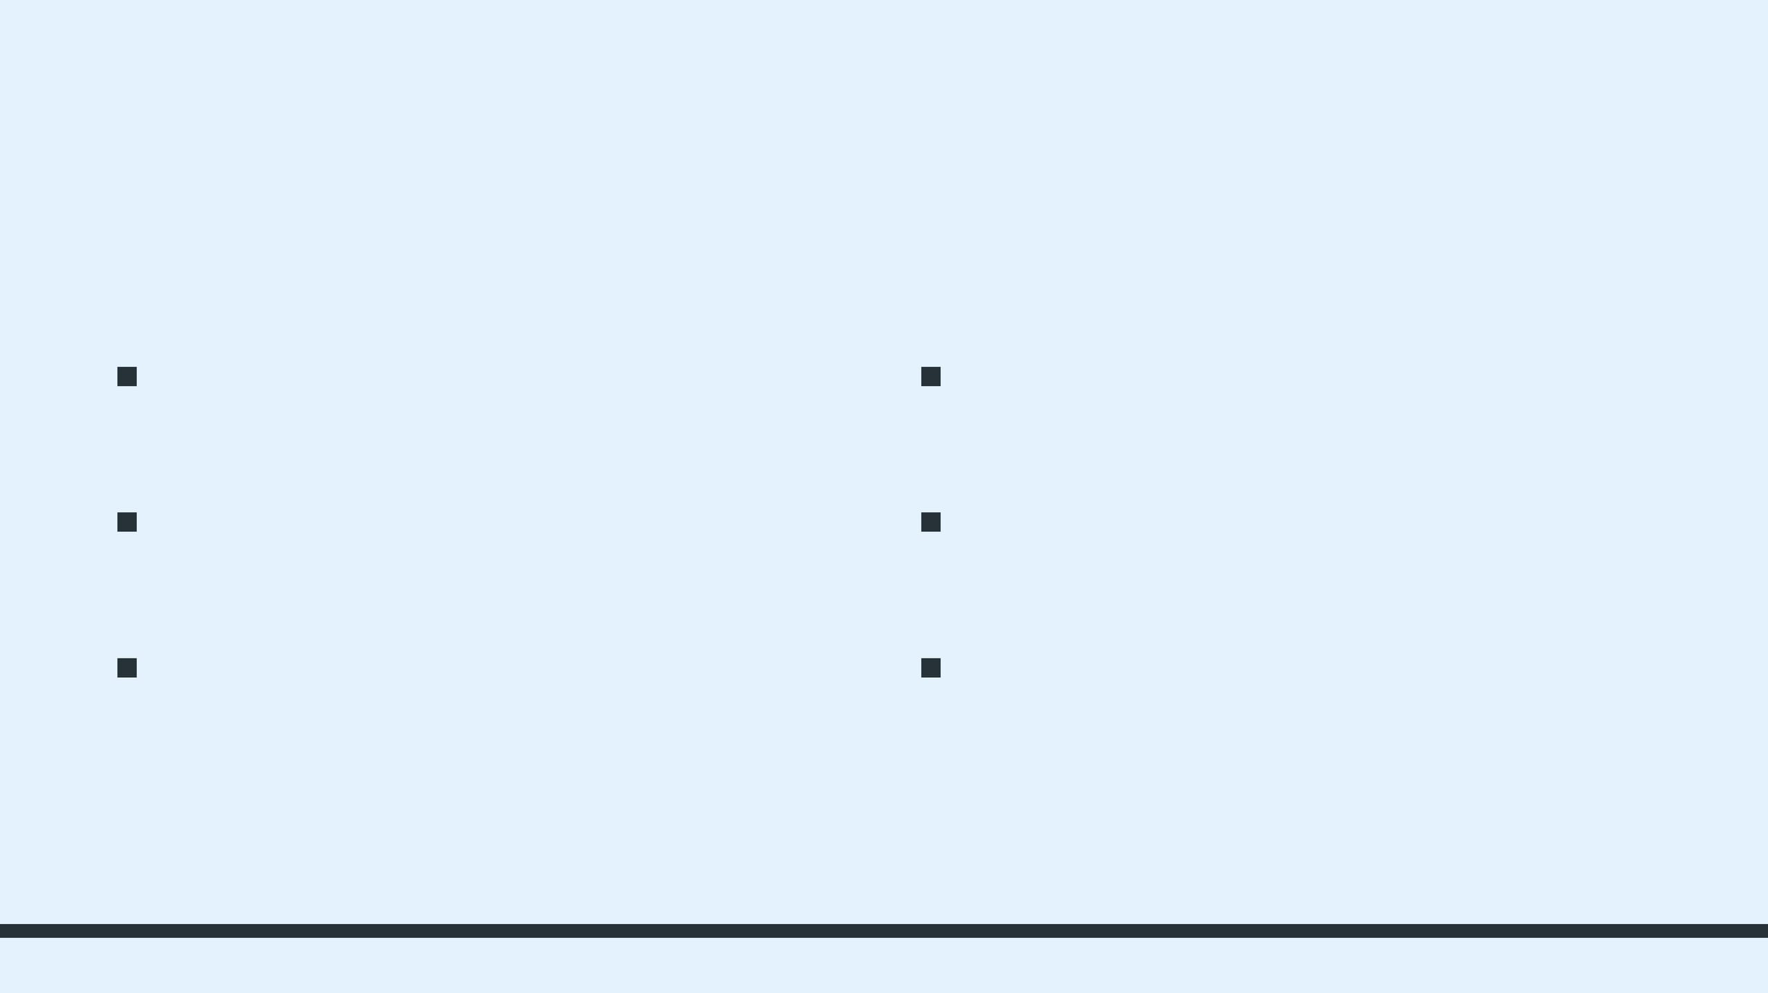
NON-FUNCTIONAL STANDARDS & SOFTWARE HETEROGENEITY
NON-FUNCTIONAL CONSTRAINTS
ADVANCED ARCHITECTURE SUITE
Performance
CQRS Pattern
System must handle <0.5s for 200 concurrent operations to ensure real-time responsiveness.
Separating Attendance "Writes" from analytical Report "Reads" for optimized scaling.
Security
Event-Driven Integration
JWT-based Role-Based Access Control (RBAC) for all hardware and mobile endpoints.
Using a Message Broker to notify door-lock systems upon valid swipe events.
Availability
API Gateway
Edge Caching strategies to provide offline attendance resiliency during network outages.
Centralized entry point for managing traffic, security, and protocol translation.
Notes:
To wrap up, architecture isn't just about classes; it's about meeting non-functional standards. We need Performance, Security, and Availability. To achieve this, we use advanced patterns: CQRS to separate heavy writing from fast reading, Event-Driven architecture to link attendance to door locks without tight coupling, and API Gateways to secure our endpoints. This holistic view ensures our software is not just well-designed, but production-ready. Thank you.

